Slide 1
Comparing Sorting Algorithms

Slide 2
01
TABLE OF CONTENTS
02
03
Short description of each algorithm
Especially the running time
Comparisons between algorithms
When should one algorithm be used instead of another?
Bibliography

Slide 3
01
Short description of each algorithm

Slide 4
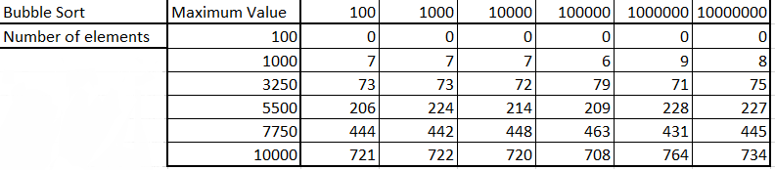
(Optimized) Bubble Sort
Comparison based sorting: Yes;
Idea: repeatedly swapping the adjacent elements if they are in wrong order;
Worst and Average Case Time Complexity: O(n^2);
Worst case: occurs when array is reverse sorted;
Best Case Time Complexity: O(n);
Best case: occurs when array is already sorted;
Auxiliary Space: O(1);
Boundary Cases: Bubble sort takes minimum time (Order of n) when elements are already sorted;
Sorting In Place: Yes;
Stable: Yes.
What is the running time (in ms)?

Slide 5
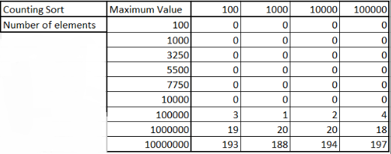
Counting Sort
Comparison based sorting: No;
Idea: counting the number of objects having distinct key values (kind of hashing);
Time Complexity: O(n+k) where n is the number of elements in input array and k is the range of input;
Auxiliary Space: O(n+k);
Stable: Yes;
Efficiency: it is efficient if the range of input data is not significantly greater than the number of objects to be sorted.
What is the running time (in ms)?

Slide 6
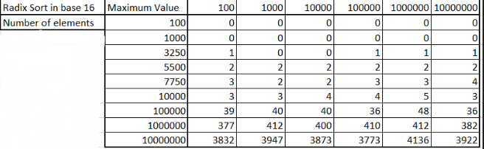
Radix Sort in base 16
Comparison based sorting: No;
Idea: creating and distributing elements into 16 buckets according to their radix;
Time Complexity: O((n+16) * log16(k));
Auxiliary Space: O(16);
Stable: Yes;
! It is better to use this base when the maximum value of the elements is small, consuming less memory.
What is the running time (in ms)?

Slide 7
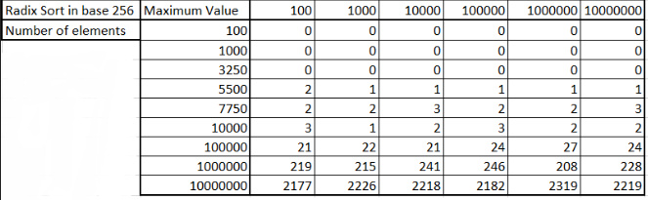
Radix Sort in base 256
Comparison based sorting: No;
Idea: creating and distributing elements into 256 buckets according to their radix;
Time Complexity: O((n+256) * log256(k));
Auxiliary Space: O(256);
Stable: Yes;
! It is better to use this base when both the maximum value of the elements and the maximum number of elements is large, being faster.
What is the running time (in ms)?

Slide 8
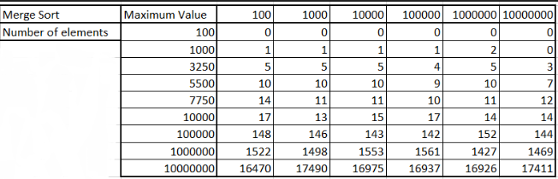
Merge Sort
Comparison based sorting: Yes
Idea: divides the input array into two halves, calls itself for the two halves, and then merges the two sorted halves;
Algorithmic Paradigm: Divide and Conquer;
Time complexity: It falls in case II of Master Method and the solution of the recurrence is θ(nLogn);
Auxiliary Space: O(n);
Sorting In Place: No;
Stable: Yes.
What is the running time (in ms)?

Slide 9
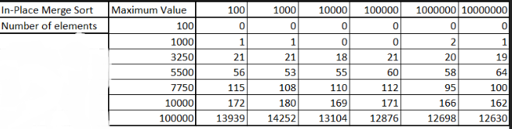
In-Place Merge Sort
Comparison based sorting: Yes
Idea: divides the input array into two halves, calls itself for the two halves, and then merges the two sorted halves;
Algorithmic Paradigm: Divide and Conquer;
Time complexity: O(n2) because merge is O(n2)
Auxiliary Space: does not occupy extra memory for merge operation as in standard case;
Sorting In Place: Yes;
Stable: Yes.
What is the running time (in ms)?

Slide 10
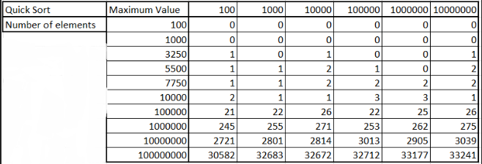
Quick Sort
Comparison based sorting: Yes;
Idea: selecting randomly a 'pivot' element from the array and partitioning the other elements into two sub-arrays, according to whether they are less than or greater than the pivot;
Time Complexity: O(nlogn);
Sorting In Place: Yes;
Stable: No.
What is the running time (in ms)?

Slide 11
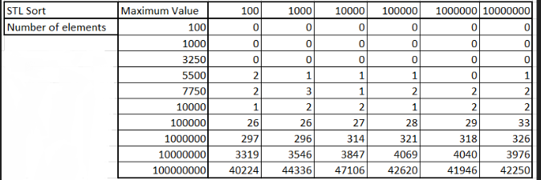
STL (Native) Sort
Comparison based sorting: Yes;
Idea: internally uses IntroSort - implemented using hybrid of QuickSort, HeapSort and InsertionSort.By default, it uses QuickSort but if QuickSort is doing unfair partitioning and taking more than N*logN time, it switches to HeapSort and when the array size becomes really small, it switches to InsertionSort;
Time Complexity: O(nlogn);
Memory: O(logn);
Stable: No.
What is the running time (in ms)?

Slide 12
02
Comparisons between algorithms
Using the tables presented above, we will observe when we have to use a certain sorting algorithm to the detriment of the other.

Slide 13
When we have a few number of elements (maximum 10^4), but they can have large values (10^6-10^7), we should use Bubble Sort because the auxiliary array for Counting Sort cannot contain that many elements. Otherwise, we use Counting Sort because its running time is 0 ms for a number of 10^4 elements. Moreover, for 10^5 the maximum time is 4 ms, for 10^6 it is 20 ms and for 10^7 it is 197 ms.
Bubble Sort
Counting Sort
Accepted maximum value (Max): 10^7
Accepted no. of elements (n): 10^4
Accepted maximum value (Max): 10^5
Accepted no. of elements (n): 10^7

Slide 14
When we have large values (10^6-10^7), we should use Radix Sort because the auxiliary array for Counting Sort cannot contain that many elements. Otherwise, we should use Counting Sort because its running time is 0 ms for a number of 10^4 elements. Moreover, for 10^5 the maximum time is 4 ms, for 10^6 it is 20 ms and for 10^7 it is 197 ms. Although, if we have limited memory, we can use Radix Sort because it uses an auxiliary space equal with the number of buckets (16 or 256 in our case), in contrast to the counting sort that uses an additional array of 10^5 elements. (The same happens with the other sorting algorithms.)
Radix Sort
Counting Sort
Accepted maximum value (Max): 10^7
Accepted no. of elements (n): 10^7
Accepted maximum value (Max): 10^5
Accepted no. of elements (n): 10^7

Slide 15
For a number of elements in range [1, 10^5], both sorting algorithms are efficient, Quick Sort being slightly faster. For a number of elements bigger than 10^5, Radix Sort is more efficient (for 10^7 elements the difference is aprox 600 ms.) , but it uses additional memory in contrast with the other.
Radix Sort in base 256
Quick Sort
Accepted maximum value (Max): 10^7
Accepted no. of elements (n): 10^7
Accepted maximum value (Max): 10^7
Accepted no. of elements (n): 10^8

Slide 16
For a number of maximum 10^3 elements, they have a similar efficiency, and because In-Place Merge Sort does not use auxiliary space, it can be recommended to use In-Place Merge Sort. For more than 10^3 elements, In-Place Merge Sort becomes much more inefficient, so we should use Merge Sort.
Merge Sort
In-Place Merge Sort
Accepted maximum value (Max): 10^7
Accepted no. of elements (n): 10^7
Accepted maximum value (Max): 10^7
Accepted no. of elements (n): 10^5

Slide 17
Bibliography
https://en.wikipedia.org/
https://www.geeksforgeeks.org/
https://stackoverflow.com/

